Slide 1
Samsung Innovation Campus
Artificial Intelligence Course
Notes:
Note:
1

Slide 2

Medical Cost Personal
Notes:
Note:
2

Slide 3
Index
Team
About
Content
DEA
Analyze by describing data
Modeling
Conclusion

Slide 4
Team
Rawan El Farmawy
Yasmin Osama
Ziad Omar Yousef
Members of Eng. Maryam Ashraf's team

Slide 5
About
The dataset is for a group of residents in the United States and contains some information about them as well as health insurance charges, in order to be able to determine insurance charges later.

Slide 6
Content
age: age of primary beneficiary
sex: insurance contractor gender, female, male
bmi: Body mass index, providing an understanding of body, weights that are relatively high or low relative to height, objective index of body weight (kg / m ^ 2) using the ratio of height to weight, ideally 18.5 to 24.9

Slide 7
Content
children: Number of children covered by health insurance / Number of dependents.
smoker: Smoking
region: the beneficiary's residential area in the US, northeast, southeast, southwest, northwest.
charges: Individual medical costs billed by health insurance.

Slide 8
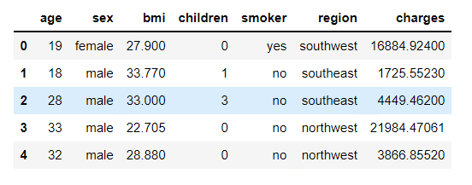
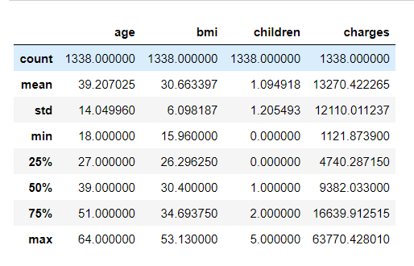
Analyze by describing data
data format
data description
Notes:
Note:
More information can be found at
+Classifier: https://scikit-learn.org/stable/modules/generated/sklearn.ensemble.AdaBoostClassifier.html
+Regressor: https://scikit-learn.org/stable/modules/generated/sklearn.ensemble.AdaBoostRegressor.html
8

Slide 9
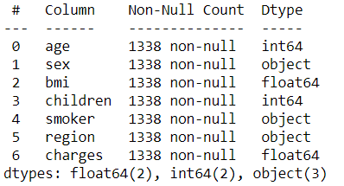
Analyze by describing data
Information
Findings:
There are four numerical variables: - Continuous: - Age - BMI - Charges - Discrete: - children There are three categorical variables: - Sex - Smoker - Region

Slide 10
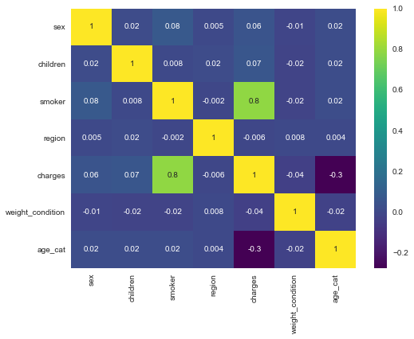
Analyze by describing data
is there is a relationship between the features and each other?

Slide 11
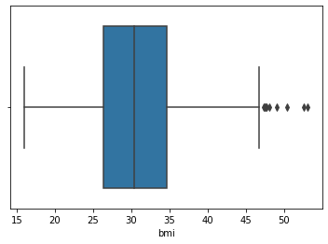
Analyze by describing data
Does it indicate that the data is really stable? check the outliers...
I got them 😈

Slide 12
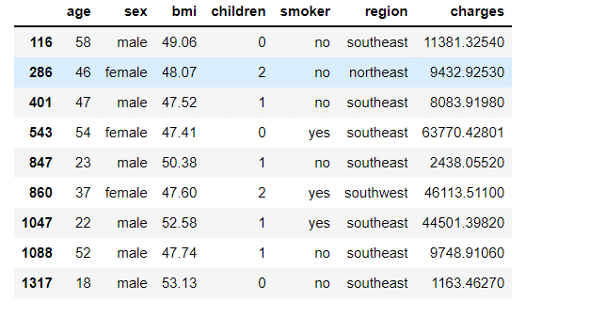
Analyze by describing data
Let's find out which this data is..
only 9 records! we can get red of them safely

Slide 13
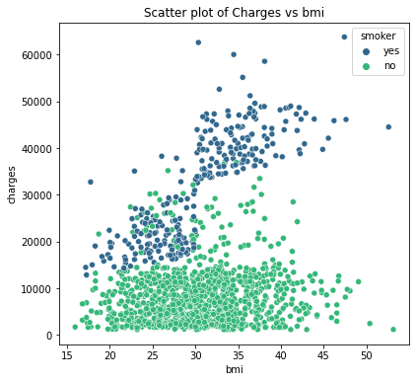
DEA
take a look at the features and its effect in the target "charges" …
insights:
Most of the people who smoke are obese people
Even though a person is not obese but he/she smokes, his/her charges tends to be higher.

Slide 14
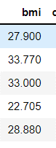
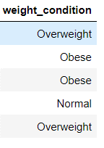
DEA
I see that It will be clearer if we classify people into categories according to their "bmi" 💡
bmi < 18.5 , be underweight
bmi > or = 18.5 & bmi <24.5 , be normal
bmi > or = 24.5 & bmi < 30 , be overweight
bmi > 30 , be obese

Slide 15
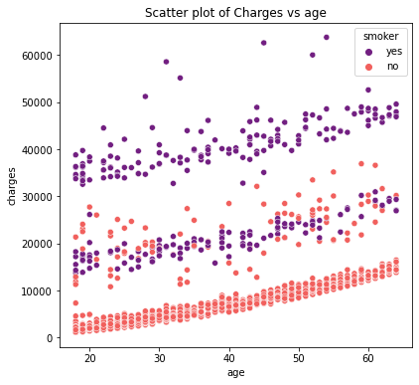
DEA
age VS charges
Insights
Charges increases as the age of the person increases
Smokers and obese people have the highest charges regardless of their age.

Slide 16
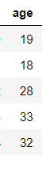
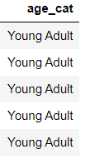
DEA
I'll do the same thing with "age" so that the data to be follow the same flo 🤙🏻
Age <= 35 year , be Young Adult
Age <=50 year , be Senior Adult
Age > 50 year , be Elder

Slide 17
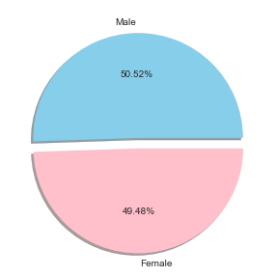
DEA
Relation between sex and charges:
Almost the same proportion...

Slide 18
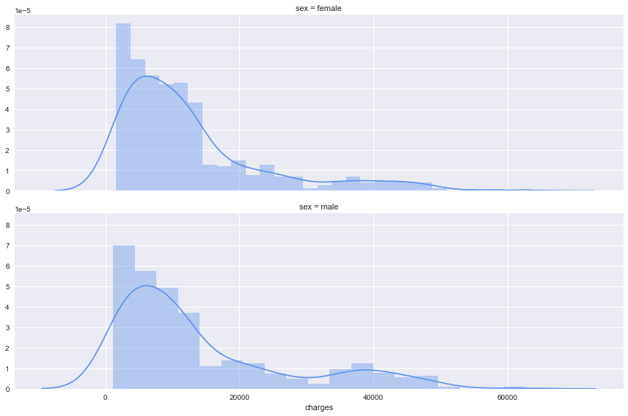
DEA
Checking the charges distributions for males and females
As we can see the two distributions are almost the same for both women/men, so we can affirm that there is no influence on the medical charges when it comes to the sex variable.

Slide 19
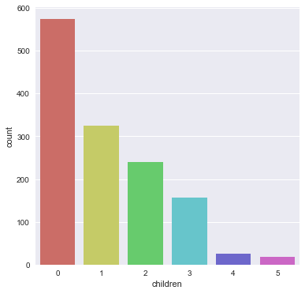
DEA
let's see how many children our patients have.
Most patients do not have children

Slide 20
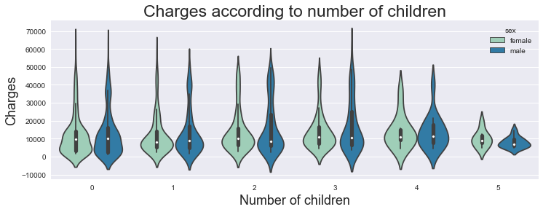
DEA
Creating a violin plot for each category
As we can see, almost all categories have the same range and mean of costs also the distributions are very similar, except for the people who have 5 children. This might be because of the small size of the sample of this kind of people!

Slide 21
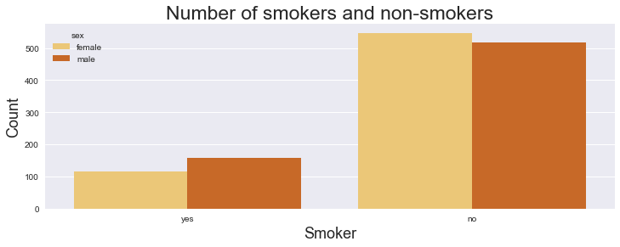
DEA
Relation between smoking and charges:
As we can see charges for smokers are much higher than charges for non-smokers. Sex doesn't have any effect on charges when you are a smoker

Slide 22
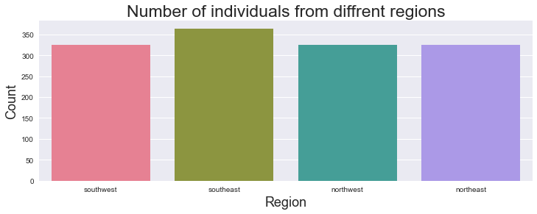
DEA
Relation between regions and charges:
Almost all the regions have equal number of individuals.

Slide 23
Conclusion
We have found out that region and gender does not bring significant difference on charges among its groups. Age, BMI, number of children and smoking are the once that drives the charges.
As:
age has an impact on the charges, when a person is older the health costs are larger.
if you are a smoker you must expect some huge medical charges compared to non-smokers. Especially for people who have high BMI values (>35) it will result very serious health care charges.
no matter where you live, this won't have any impact on your medical insurance bills.
the number of children doesn't affect the medical costs billed by health insurance.
it doesn't matter if you are a men or a women your health bills won't change.

Slide 24
Modeling
From the data analyzes we found that it is possible to drop [sex & regions]
Then we reprocessed the data like label Encoding and others..
Also, we split the data based on the features and the target, and train & test and then we started the algorithm tests to choose from.
We tested eight algorithms :
Linear Regression
KNeighborsRegressor
DecisionTreeRegressor
RandomForestRegressor
AdaBoostRegressor
GradientBoostingRegressor
XGBRegressor
CatBoostRegressor

Slide 25
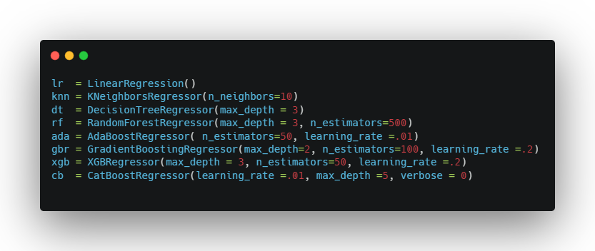
Modeling
We have set parameters for each algorithm based on the best result.. We got them after a lot of searching

Slide 26
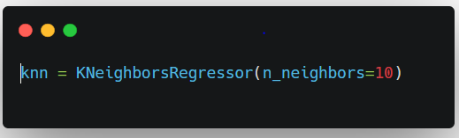
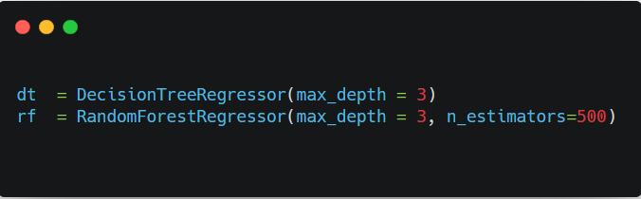
Modeling
What about parameters !
1-
2-

Slide 27
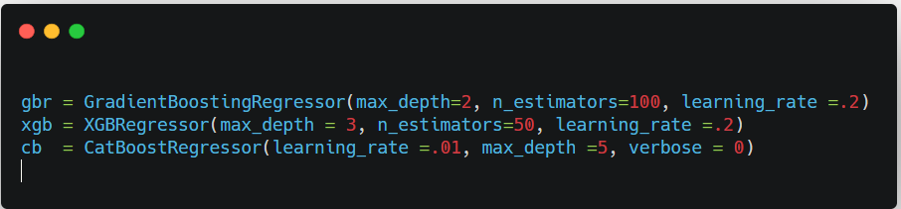
Modeling
3-

Slide 28
Modeling
Why didn't we use Gridsearch ?
We found …
It takes too much time to make the selection process
In most algorithms it does not choose the best case
When we searched for the best values of parameters to put.. the results of our search were better than Gridsearch

Slide 29
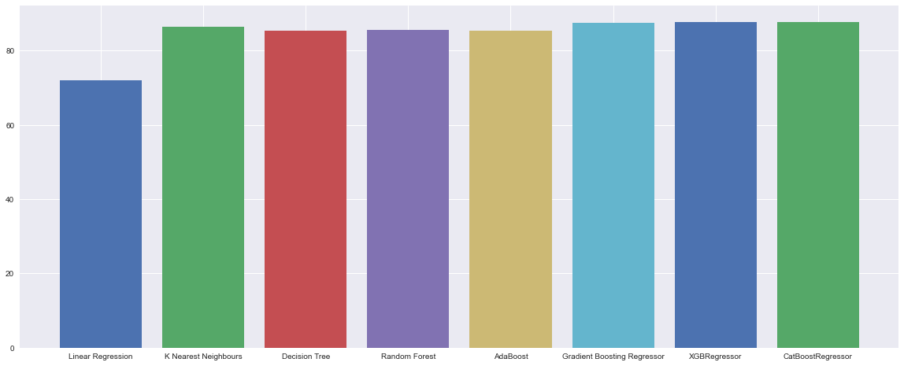
Modeling
Results :

Slide 30
Modeling
Linear Regression : 72 %
K Nearest Neighbours : 86 %
Decision Tree : 85 %
Random Forest : 86 %
AdaBoost : 85 %
Gradient Boosting Regressor : 88 %
XGBRegressor : 88 %
CatBoostRegressor : 88 %
Best Models
Gradient BoostingRegressor : 88 %
CatBoostRegressor : 88 %
XGBRegressor : 88 %

Slide 31
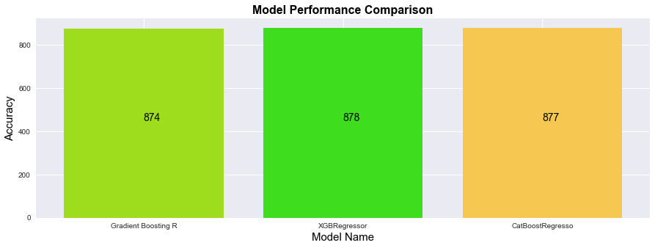
Modeling
R square (r2) Score & Root Mean Squared Error(RMSE) :

Slide 32
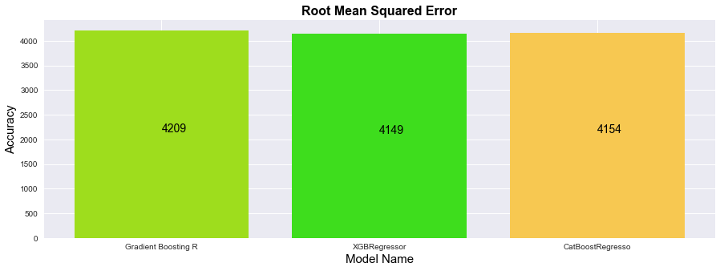
Modeling
Root Mean Squared Error(RMSE):
It is the squared root of the mean of the difference between actual and the predicted values.

Slide 33
Modeling
What are the advantages of this algorithm?
It is designed to handle missing data with its in-build features.
It Works well in small to medium dataset
One nice feature of Trees (XGBoost, Random Forest, etc.) is you don’t have to normalize your features as you should with SVM, etc
work well if the data is nonlinear, non-monotonic, or with segregated clusters.
Disadvantages:
can over-fit the data, especially if the trees are too deep with noisy data.

Slide 34
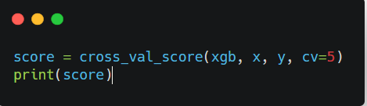
Modeling
Cross Validation
It is a resampling procedure which is used to evaluate the machine learning models on limited data samples. Its goal is to predict new data that is that is not tested before.
[0.85890086, 0.79149981, 0.85040421,
0.83031141, 0.86551417]

Slide 35
Where is the code
GitHub : https://github.com/Ziad-o-Yusef/MCP
Kaggle :

Slide 36

Questions?
Samsung Innovation Campus

Slide 37
Thank you
Samsung Innovation Campus

